Slide 1
Welcome Patriot families
Summer freshman orientation 2022

Slide 2
Academic Information
Ms. Kelly Aycock, counselor
Mrs. Vicky Ospina, counselor

Slide 3
Florida Graduation Requirements
24 Credits
4 English
4 Math (Including Algebra 1 and Geometry)
3 Science (Including Biology)
3 Social Studies (Including World & US History, Government & Economics)
1 Fine/Practical Art
1 PE
8 Elective
2.0 or greater GPA (C average)
State Exams
Pass Algebra 1 EOC
Pass 10th ELA FSA exam
Take Geometry, Biology, US History EOC
Take Online course through Osceola Virtual School
Planning for College TIP:
World Language is not required for HS Graduation….BUT it IS required for College Admission and scholarships.
Need 2 consecutive years in the same language

Slide 4
Diploma Designations
Scholar Diploma Designation
Merit Diploma Designation
2 Credits Higher Level Math
Algebra II, Statistics, or equally rigorous math course
2 Credits Higher Level Science
Chemistry or Physics and one equally rigorous science course
2 Credits in same World Language
1 Credit in AP, IB or DE course
Pass all EOC Exams: Geometry, Biology, US History
Earns one or more industry certifications
Biliteracy Seal
Earn 4 credits in the same language and pass FSA with a 4 or higher
OR
Pass AP Exam with 3 or higher

Slide 5
Clubs & Extracurricular Activities
Activist Power Club
AimBots Robotic Club
Any Book Club
Battle of the Books
Black Student Union (BSU)
Domino Club
Gay Straight Alliance (GSA)
Interact Club
Media Center Krew
National Technical Honor Society
Photography Club
SkillsUSA
Spanish Honor Society
Student Announcements
Yearbook

Slide 6
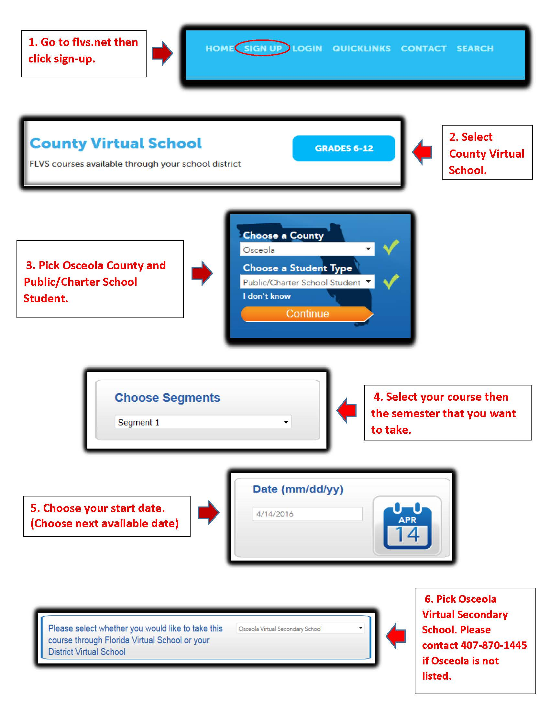
Osceola Virtual School
It is a requirement that students take and pass one online course through Osceola Virtual School
Some popular options:
Driver’s Education
Peer Counseling
HOPE
Students must speak to their School Counselor for approval when signing up for a class.

Slide 7
Dual-Enrollment
Take college classes FOR FREE! Including tuition and textbooks!
Replace your high school requirements with college classes!
Qualifying Requirements:
GPA 3.0 or higher
Take and pass all three sections of PERT Exam
Complete a Valencia DE application.
DE application Window:
Next PERT Exam:
– Be sure to sign up on the form shared on Remind as the date gets closer.

Slide 8
Community Service Hours
Find fun and interesting ways to volunteer (try to find opportunities in your field of interest). The sooner you start, the more you’ll earn throughout your high school years.
Volunteer hours are NOT required for graduation but they are HIGHLY recommended.
Cannot include any paid service or assisting in a for-profit organization (with the exception of hospitals and nursing homes).
Can include assisting at non-profit organizations/charities during student’s own time including after school and weekends.
Bright Futures Volunteer Service information can be found at
Speak to your School Counselor about service hours and Proposal for Bright Futures.

Slide 9
Community Service Opportunities (some examples)
Community Service for
Florida Bright Futures Scholarship
COMMUNITY SERVICE is defined as identifying a social issue in the community. This requires students to look beyond themselves and reach out to an issue faced by our society today (i.e. poverty, abuse, elderly rights, etc.). These hours will meet the requirement for the Bright Futures scholarships.
Goodwill Industries
Habitat for Humanity
Humane Society
Make a Wish Foundation
March of Dimes
Gift for Teaching
Give Kids the World
Elementary & Middle Schools
Big Brother/Sister
American Red Cross
Florida Academic Scholarship – 100 hours
Florida Medallion Scholarship – 75 hours
Florida Gold Seal Vocational Scholarship – 30 hours
Florida Gold Seal CAPE Scholarship – 30 hours
See your School Counselor for a community service proposal or visit our school website at https://www.osceolaschools.net/Page/8177

Slide 10
OTECH Dual-Enrollment
All students at PATHS are expected to enroll and complete a Career Certificate program at oTECH
Program tours and Tech Immersion in 10th grade.
Then students choose 1st, 2nd, and 3rd Tech choice.
Juniors attend 3rd & 4th period, Seniors attend 1st & 2nd period
Students must be in good standing for oTECH admission: grades, credits, GPA, testing requirements, attendance, and behavior.
Potential programs (may change prior to 11th grade):
Medical Assisting
Medical Billing & Coding
Pharmacy Technician
Digital Design
Cybersecurity
Network Support
Culinary
Automotive
Electrical
Plubming
HVAC-R
Manufacturing
Welding

Slide 11
WIN Wednesday/ Intervention
During lunch students are required to get extra help/tutoring in a class where they are struggling.

Slide 12
Upcoming dates:
Purchase uniforms & lockers (cash or credit card) and get student I.D​.
June13th & 20th, from 10AM – 2PM
July 18th & 25th, from 10AM – 2PM
Open House
August 5th from, 4-7PM
Schedules available in Focus mid-July

Slide 13
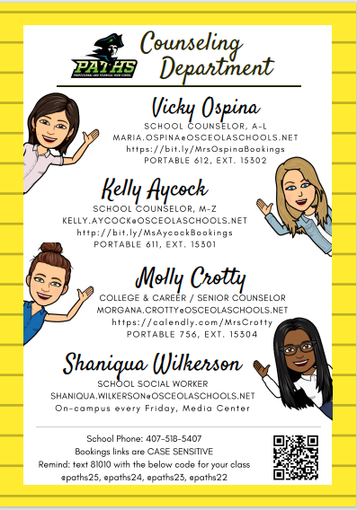
Stay Connected!
Join Remind:
@paths26
Follow Insta & FB:
@pathspatriots

Slide 14
STUDENT SERVICES
MRS. KUERS
DEAN OF STUDENTS

Slide 15
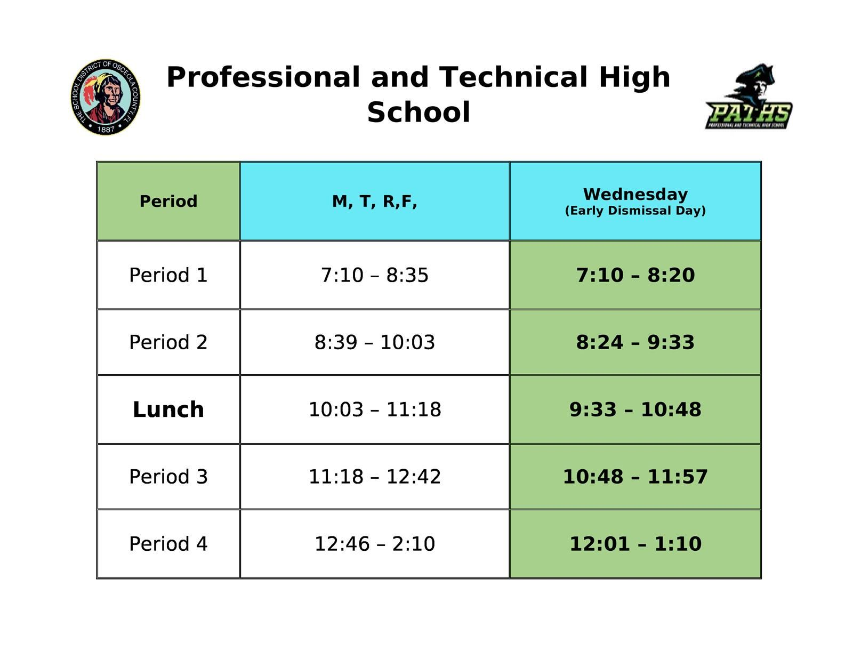
BELL SCHEDULE
DAILY LIFE AT PATHS
No students enter buildings until 6:45. Arrive on time by 7:10 tardy bell.
Buses arrive in the back, car riders in the front-two car lines side by side for pick up and drop off.
Breakfast served in café 6:45-7:05 (School and Rick’s)
Four minutes between classes. Music plays as a one minute warning. Must be in class by the bell.
Restrooms are located in the main building and inside the cafeteria. oTECH’s restrooms and adult breakroom are off limits to PATHS students. 9th and 10th graders are not allowed in oTECH except for cafeteria and media center at lunch time.
Notes:
1. Include how tardy can affect oTech acceptance and could impact your future 2. Can back up to Simpson Rd which is dangerous

Slide 16
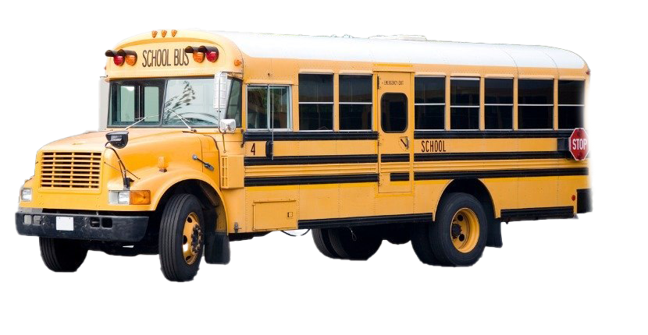
Bus route info found in focus phone # 407.518.4540
This Photo by Unknown Author is licensed under CC BY-NC
Businfo.Osceola.k12.fl.us/Transportationeligibility
Buses leave promptly at 2:15 Some students ride to Gateway to transfer to another bus

Slide 17
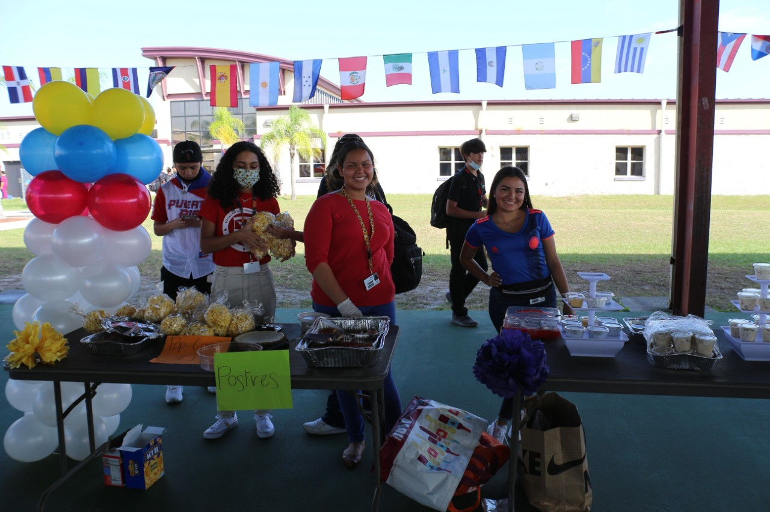
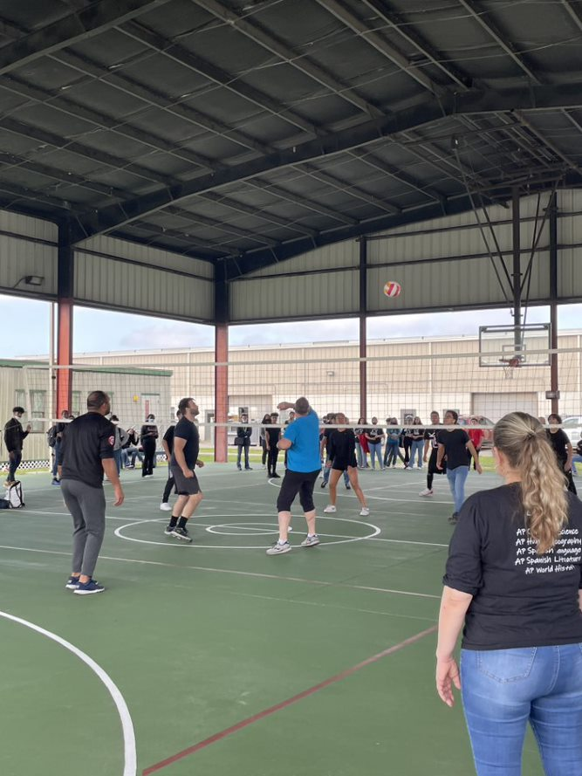
WHAT DO I DO AT LUNCHTIME?
IT’S HOW LONG?!?!?!?!?
Student lunch is an hour and 15 minutes long
Sports play includes volleyball, soccer, football , and football (bring your own- keep track of your own)
Students may use Media Center, stay in cafeteria, the outside patio, or the courts/fields
WIN Wednesday there is no sports play
At lunchtime, everyday, you must have a written pass from a teacher with your name, date and time on it in order to enter the main building

Slide 18
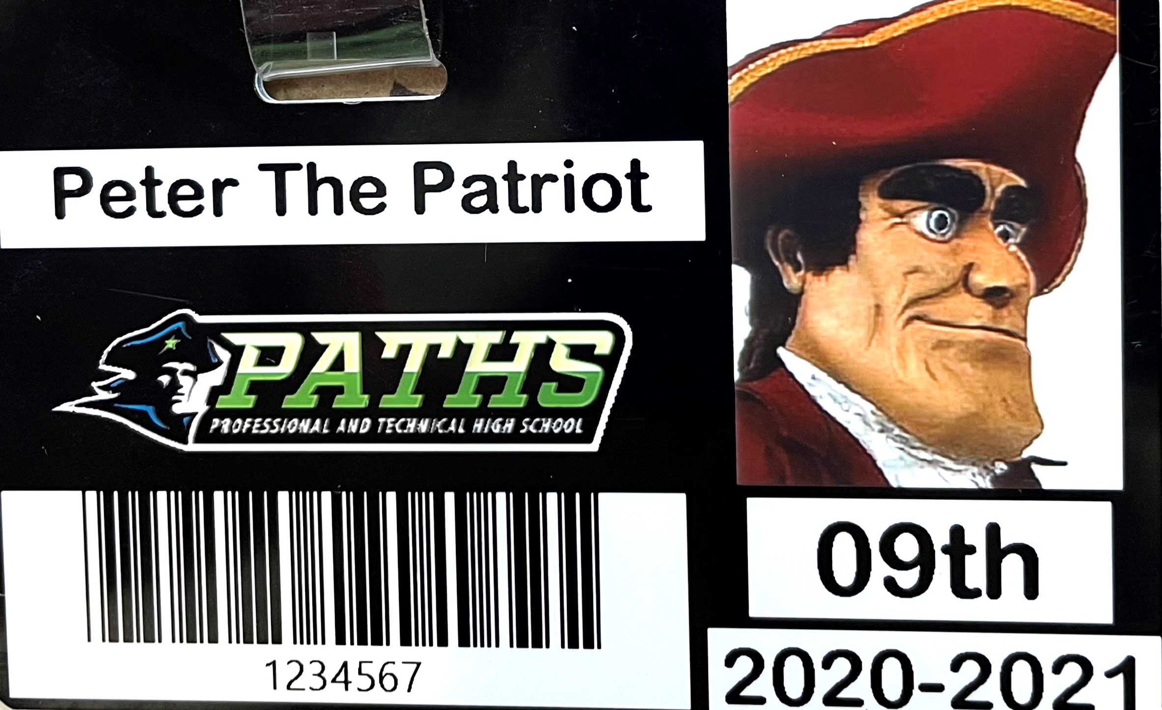
DRESS CODE & ID’S
Students will wear PATHS logo polos in blue, lime green, white, gray or black
Pants may be khaki, navy or black. No Jeans (black or blue) are allowed except on Fridays. No rips or tears in pants.No leggings or athletic wear
Appropriate length skirts may be worn in khaki, navy or black
No shorts allowed
For safety purposes, no Crocs allowed
No hoodies with the exception of a PATHS or oTECH hoody. All others must have a zipper
Spirit T-shirts allowed on Fridays with blue or black jeans
In honor of the class of 2023, students may wear a college T- shirt on the 23rd of each month
Exceptions due to oTECH requirements for Juniors and Seniors- each program has their own specific uniform
PATHS STUDENT ID MUST BE WORN AT ALL TIMES (CLIPPED ON YOUR SHIRT OR ON A LANYARD) AND VISIBLE
Notes:
All students wearing a PATHS school ID and the PATHS logo polo is imperative so that we can quickly identify a student as ours. With adults on oTECH campus, interspersed at times with our students, it becomes necessary to consistently enforce this policy.
Example of Jr/Sr uniforms vary from scrubs to a specific color t-shirt to a different color polo or culinary chef’s coat and pants

Slide 19
WHAT ABOUT SPORTS?!
INTRAMURAL SPORTS AT LUNCH
EACH QUARTER WE HOST GRADE LEVEL AGAINST GRADE LEVEL TOURNAMENTS:
BASKETBALL
VOLLEYBALL
SOCCER
This Photo by Unknown Author is licensed under CC BY-NC
ALL PATHS STUDENTS MAY PLAY FOR THEIR HOME ZONE SCHOOL OR FOR GATEWAY

Slide 20
Paths Follows the district’s code of conduct
Emergencies happen…….. Students receive 3 free tardies to school each semester
On the 4th tardy to school and 3rd tardy to class, parents are notified and lunch detention begins; it can range from 30 min to an hour, from one day to several days depending on tardy #
Still can’t get to school on time? Two hour after school character education detention is served
Finally, ISS is a last resort and bus transportation becomes the answer
WHAT HAPPENS IF I AM TARDY?

Slide 21
Dress Code Violations will follow same matrix of lunch detentions, Wed. after school detention, and ISS but there is not warning/freebie
Cell phones are not allowed out during class time. You may pick up your one to one device at Open House and this is the only device you will have out during class time. Consequences will follow the same matrix but can also include confiscation by the dean (phone locked safely away) until the end of the day. Phone use at lunch and during transitions is permissible.
Out of Area violations are serious and will result in consequences according to code of conduct
Notes:
Important or time sensitive messages can be relayed to students by the front office staff, deans, counselors etc
Give example of confiscating a phone and observing the sheer volume of texts, snapchat, Instagram alerts that popped on the screen within 15 minutes……22 different individual distractions in that short time period. Some teachers may give a brief 2 min break in the middle of a 90 min block which can include a quick phone check and then back into the backpack and back to work

Slide 22
College & Career Exploration
PATHS
Molly Crotty

Slide 23
College Week activities & events
ASVAB twice per year and military recruiter visits
College Representative Visits
Lunch tabling visits
Scheduled presentations for interested/invited students
Field trips
Campus tours & info sessions

Slide 24
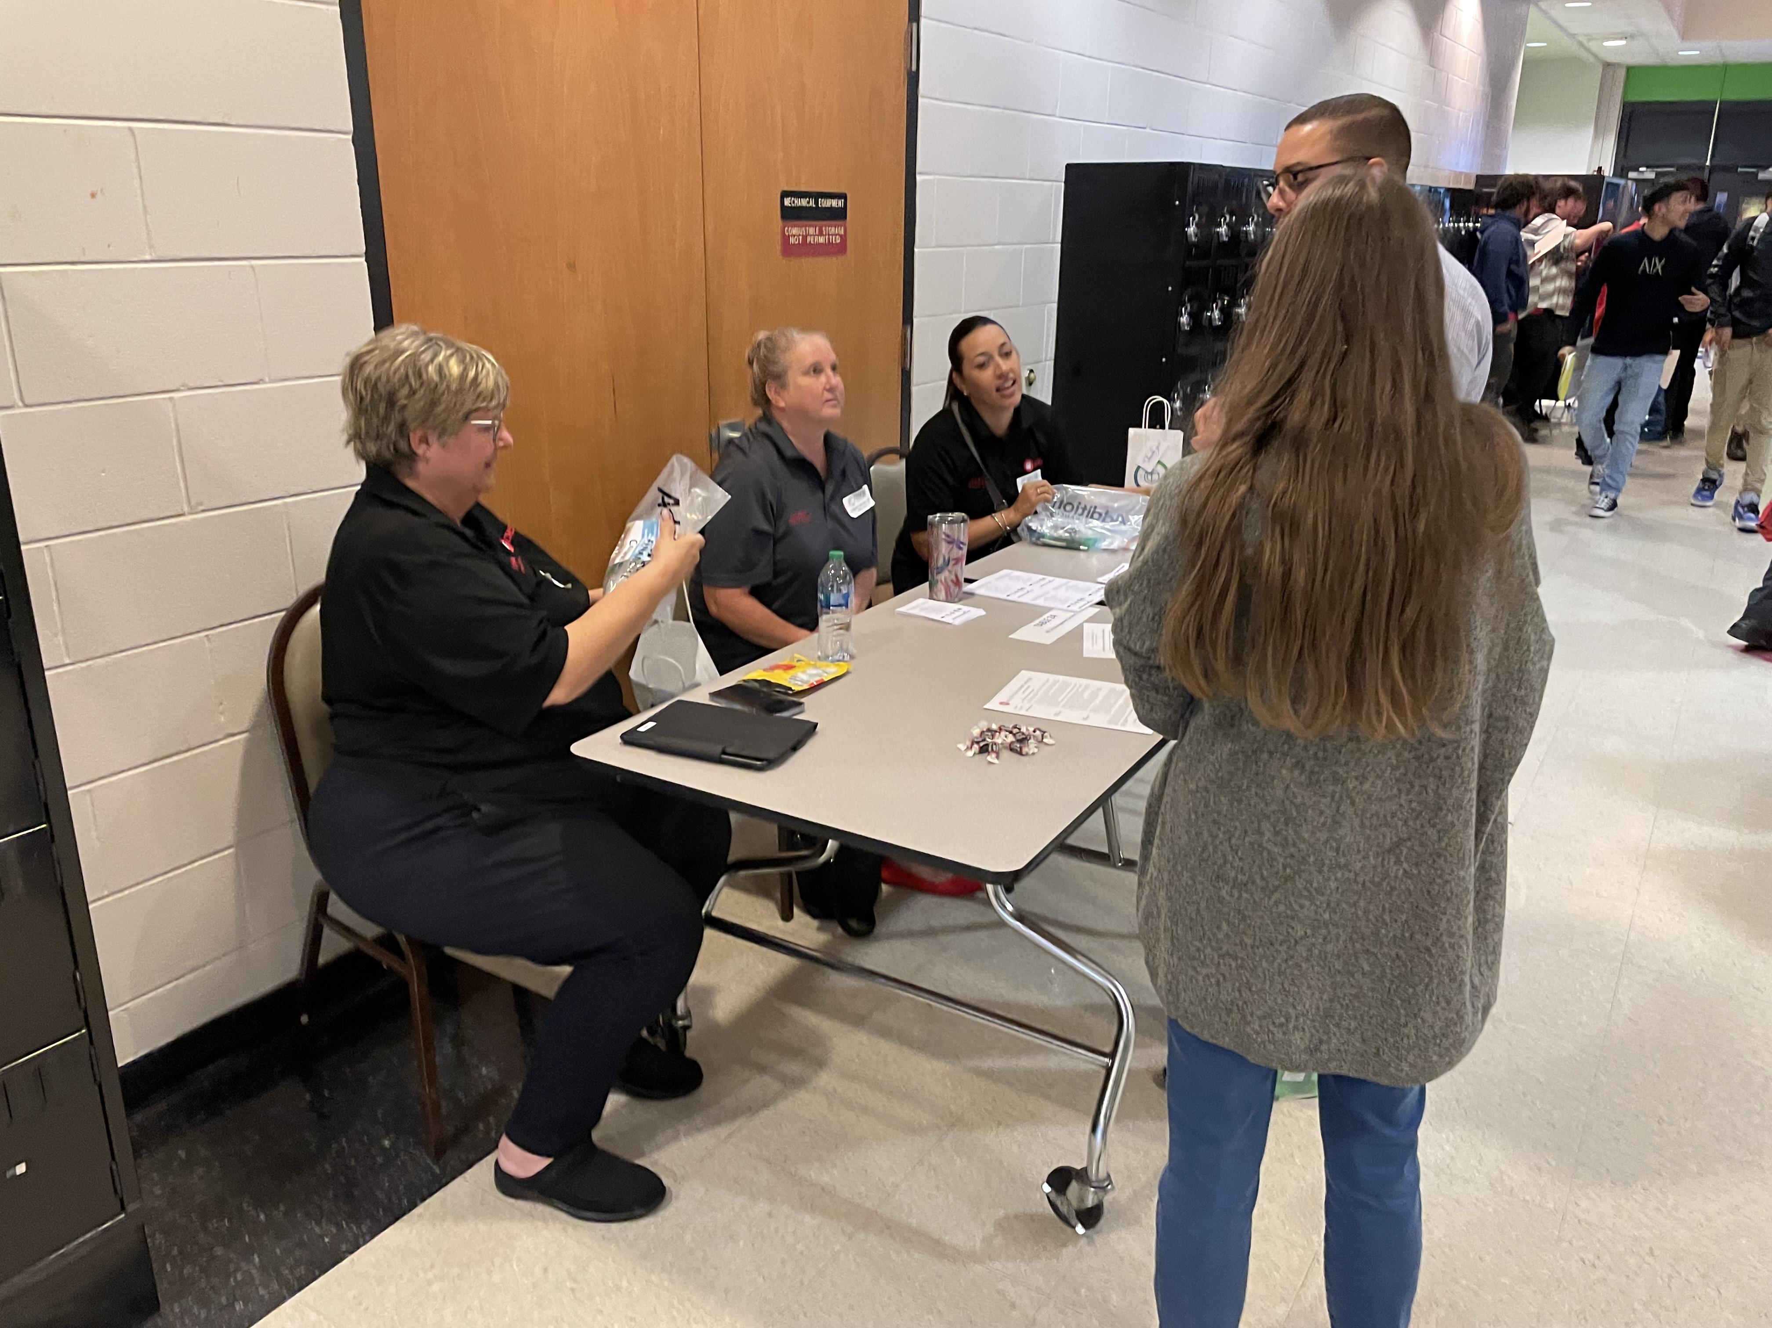
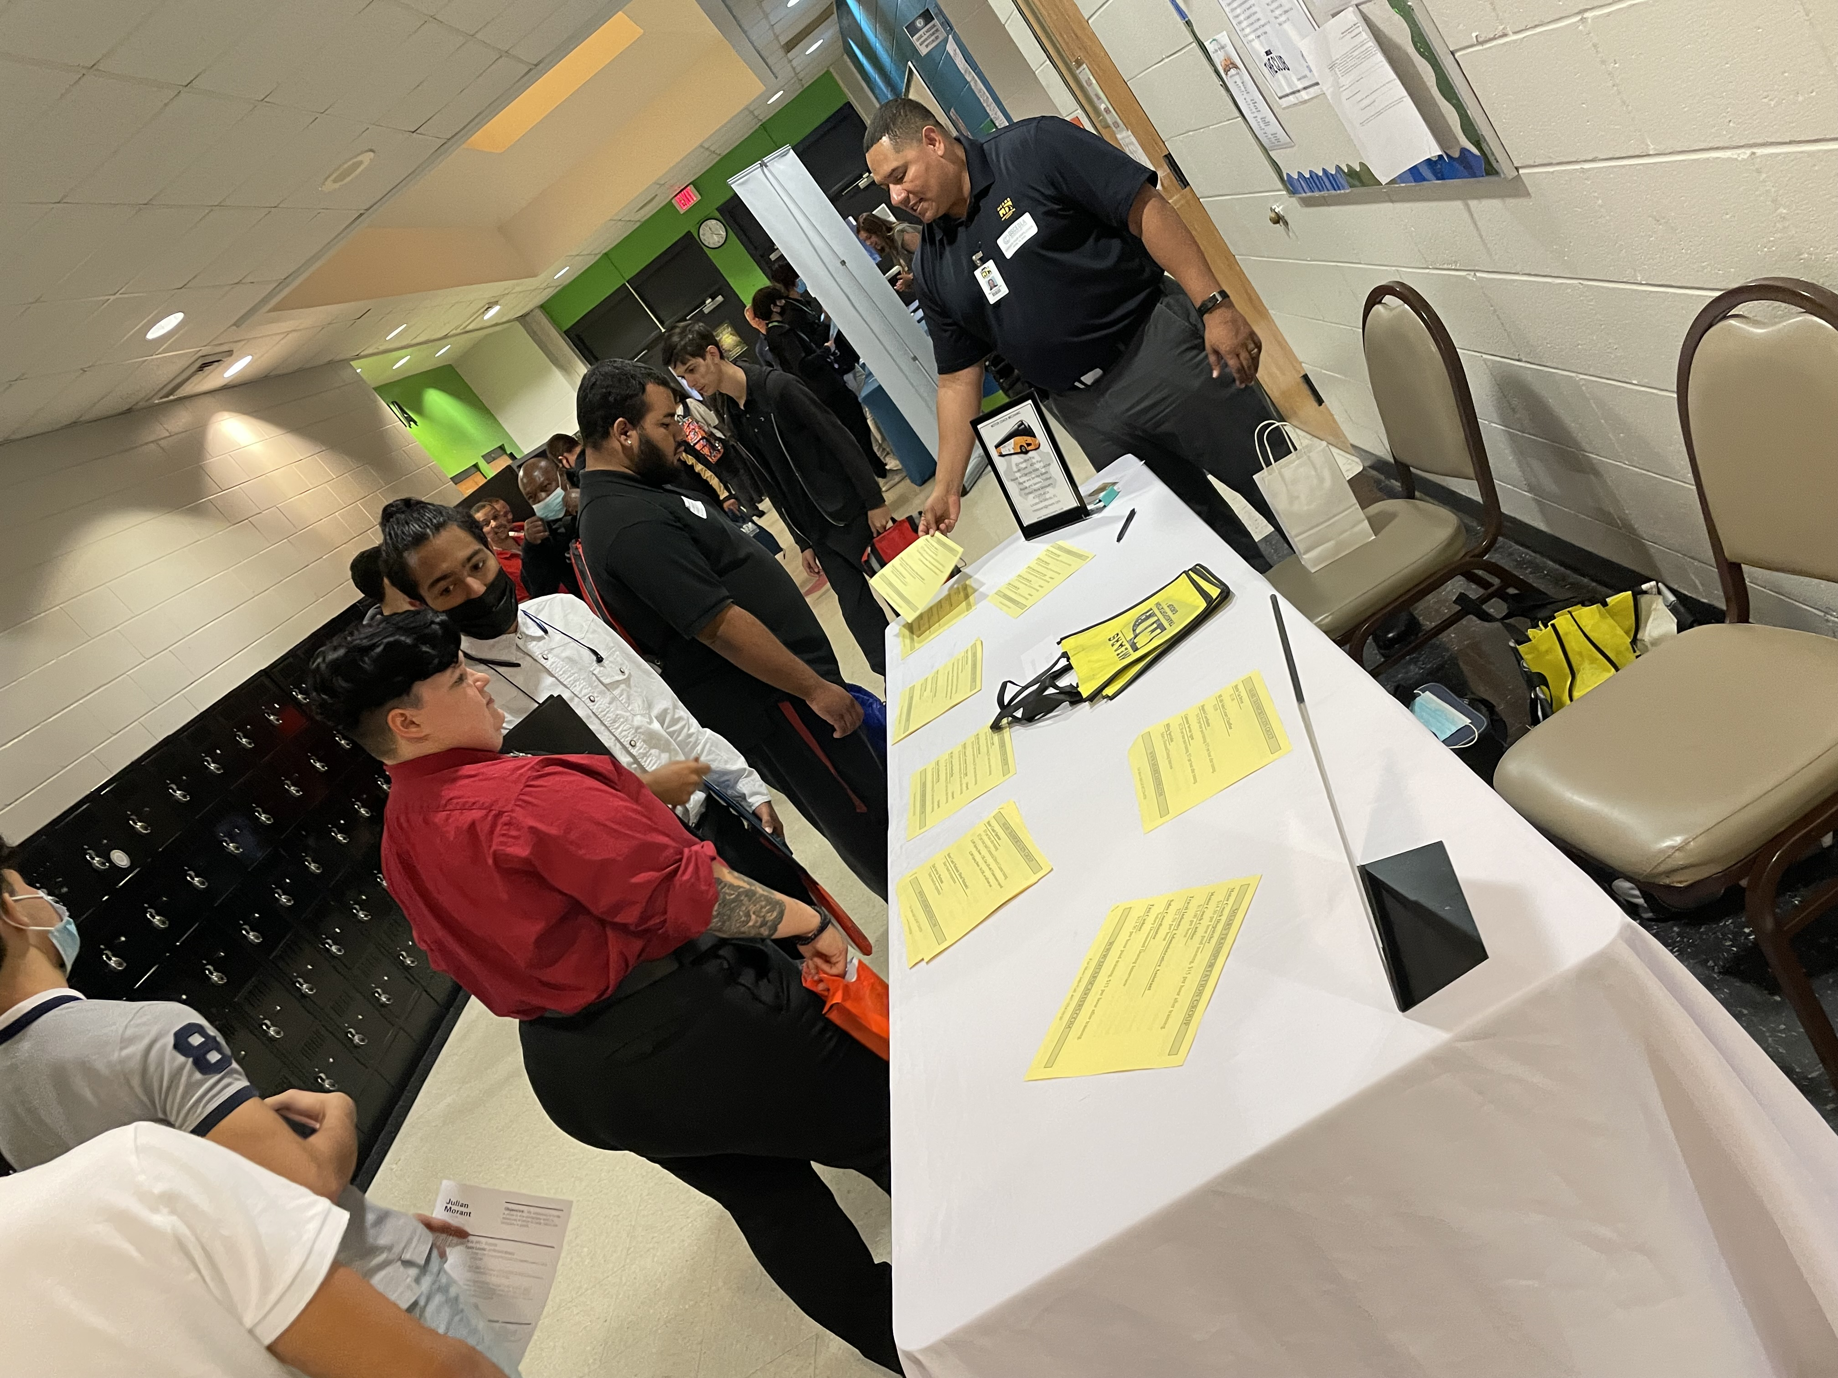
Career exposure & opportunities
oTECH Placement Coordinator, Rachel Stewart
Internships, On-site interviews
OTECH Career Fair
Over 60 employers
Tech program related and others

Slide 25
Xello research platform

Slide 26
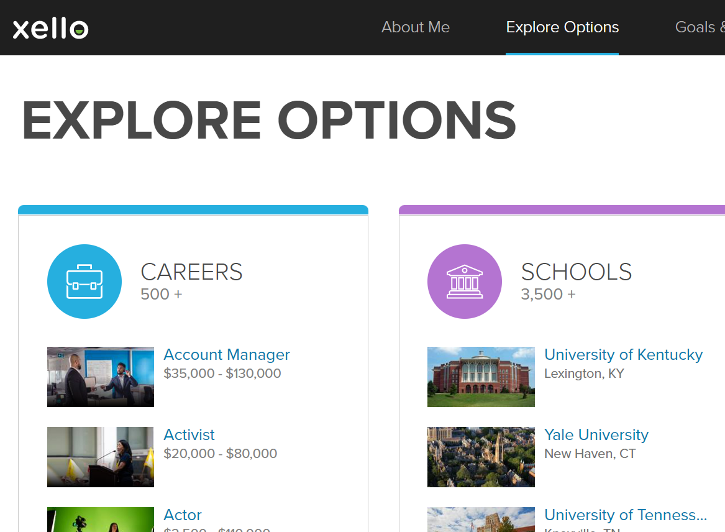
Freshman & Sophomore Year
Learning style inventory
Interest profile
Personalized Results
Goal setting
Resume Building
Career Research
Career/Major
Junior & Senior Year​
College Research
Career/Major
Finding your college fit
Scholarship Search​
College Application management
Transcripts
Letters of Recommendation

Slide 27
Scholarship& Financial Aid Help
Financial Aid Services
Scholarships Sent on Remind
Senior year- personal help with the FFAA and FAFSA applications
Bright Futures Evaluations and discussions
3 main requirements: GPA, Community Service Hours, College Entrance Test Scores
Help completing scholarship applications
Financial aid college comparisons

Slide 28
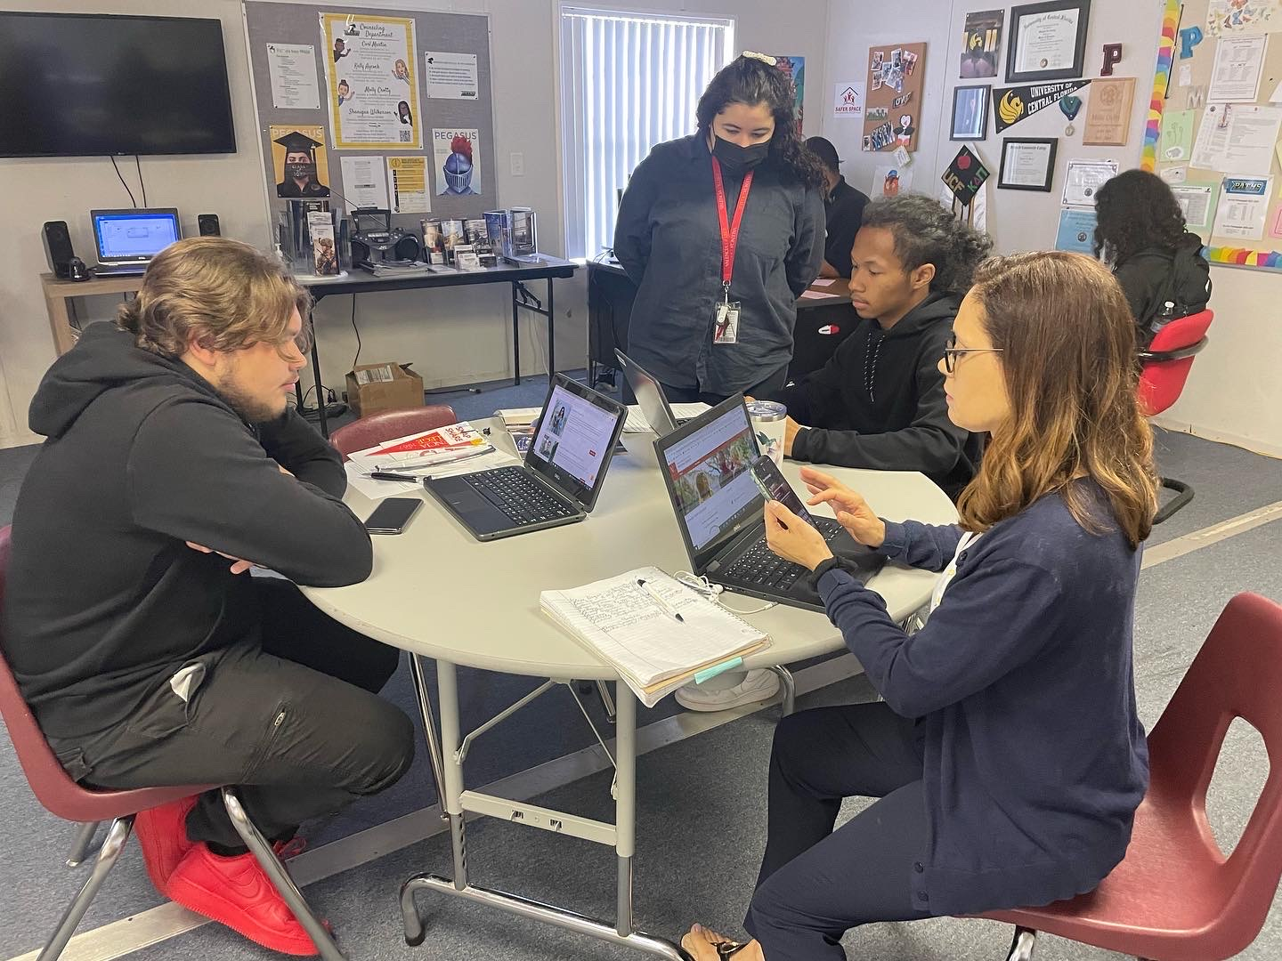
Outside Resources
Tech Express Representative
Valencia Transition Coach
Gwen Murrell
Helps students that want to transfer their oTECH credits from a completed program to a corresponding AS degree
Some programs transfer up to 24 credits
Pathway opportunities
Zoraida Santos
Helps students with transfer process from Dual Enrollment to degree seeking status during senior year
Helps with applications to Valencia College and DE in general
FAFSA Help for Families
Educational Opportunity Center
Start to finish
Every year moving forward
Grant funded non-profit company

Slide 29
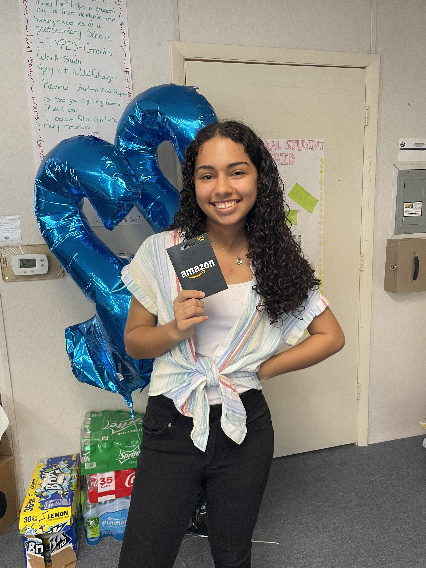
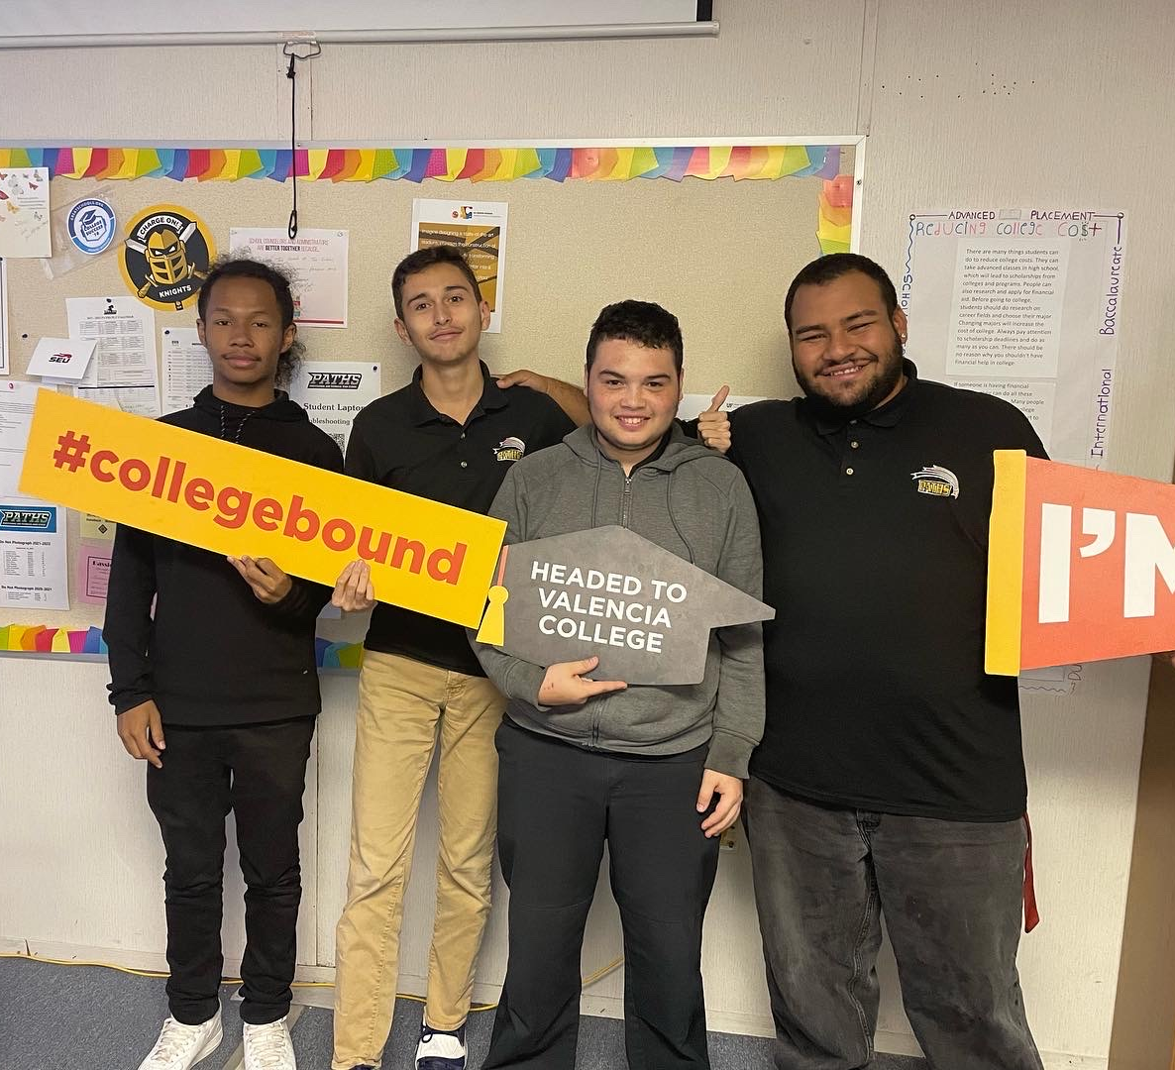
Senior year
Application Days
FAFSA Family Nights
Monthly Prize Drawings
Senior Meetings
Parties & Events!

Slide 30
Molly crotty
Senior counselor
College & Career Counselor
Morgana.Crotty@osceolaschools.net

Slide 31
Welcome to Career Dual Enrollment Orientation!

Slide 32
Today's Agenda
What is Career Dual Enrollment
Class Learning Platform & Expectations
Academic Policies/Code of Conduct/Attendance/Dress Code
Career Dual Enrollment Fees

Slide 33
What is Dual Enrollment?
High School Career Dual Enrollment is an opportunity for high school students to enroll in oTECH postsecondary courses that are weighted and creditable toward high school graduation requirements as well as postsecondary career and technical program credits and certifications.
Juniors and seniors may participate in dual enrollment provided they meet all high school graduation requirements.

Slide 34
What We Offer...​
One of the program choices you select during your junior/senior year while you prepare to graduate from high school. ​
At oTECH you can study a trade and earn a certification/s for that career.​
Earn acceleration points creditable towards high school graduation.
Earn credits towards an A.S. Degree with successful completion of our program with Valencia.

Slide 35
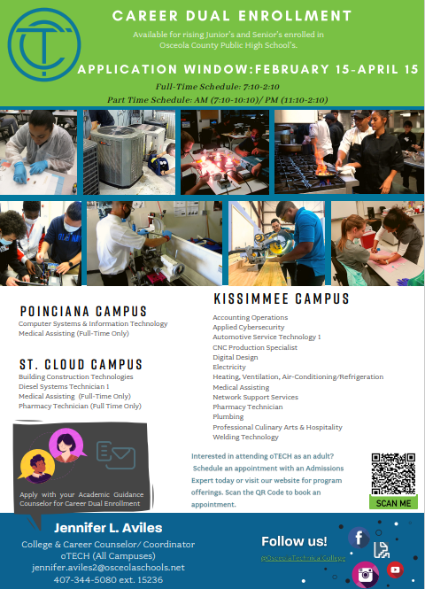
Kissimmee Campus:
Accounting Operations – 900 hours
Applied Cybersecurity – 750 hours
Automotive Service Technology 1 – 1050 hours
CNC Production Specialist – 600 hours
Digital Design – 1200 hours
Electricity – 1200 hours
Heating, Ventilation, Air Conditioning/ Refrigeration 1 – 750 hours
Medical Assisting – 1300 hours
Network Support Services – 1050 hours
Pharmacy Technician – 1050 hours
Plumbing – 1080 hours
Professional Culinary Arts & Hospitality – 1200 hours
Welding Technology – 1050 hours
Poinciana Campus:
Enterprise Desktop and Mobile Support Technology – 1050 hours
Medical Assisting – 1300 hours
St. Cloud Campus:
Building Construction Technologies – 1050 hours
Diesel Systems Technician 1 – 1050 hours
Medical Assisting – 1300 hours
Pharmacy Technician – 1050 hours

Slide 36
Are there any fees for High School Career Dual Enrolled Students?
Osceola County public high school students are provided tuition, lab fees, and textbooks FREE of charge.
Some programs may require additional supplies not covered by the school district.
Out of pockets expenses for uniforms can range from $25-$100, parking fee of $30, etc.

Slide 37
Class Learning Platform & Expectations
Instructional Expectations
We follow district guidelines for providing instruction during the 2022-2023 academic school year. All district holidays are honored at oTECH.
Face to face instruction is required to participate and earn clock hours for course completion. Daily attendance is mandatory.

Slide 38
Academic, Behavior, Attendance Expectations
Regarding Attendance:
There are no excused or unexcused absences in our postsecondary programs. The student is either present or absent.
Any student who falls below 90% attendance will be placed on an attendance contract. Students who fall below 80% attendance will be placed on academic probation and withdrawn if attendance hits 70%.
If a student is withdrawn, the current grade in the course will not be added to the student's transcript as is. Zeros will be factored into the current grade for any remaining assignments for the course.
Participation in dual enrollment programs is a choice, not a right. Per Florida statute, DE students will be held to the postsecondary standards required of that program course.

Slide 39
Program Dress Code/Dual Enrollment Fees
Students are required to dress in uniform for class while on campus.
Closed shoes are required for all programs. Certain programs have other requirements.
OTECH/PATH's ID must be always visible while on campus. Students will be required to purchase another ID if a replacement is needed.
Dress code violations will result in disciplinary action and/or dismissal of the program.
Students are approved to wear their Osceola Technical College uniform at their high school!

Slide 40
Schedule
Dual Enrollment Schedules:
Morning: 7:10 AM-10:10 AM (M/T/R/F);
(W) 7:10 AM-9:40 AM
Afternoon: 11:10 AM-2:10 PM (M/T/R/F);
(W)10:40 AM-1:10 PM
Full Time: 7:10 AM- 2:10 PM (M/T/R/F);
(W)7:10 AM-1:10 PM
YOUR SCHEDULE: Will be available in FOCUS. To access, please visit our home page and click Login. Your username and password are the same as your high school Focus account.

Slide 41
Industry Certifications
Students are expected to take the industry certifications attached to their program. These tests are program mandates and assist the student in securing employment opportunities.
Dual enrollment students first attempt is at no cost to the student. Additional attempts will be at the cost of the student.
Most certifications are provided at the oTECH Kissimmee campus, but it is possible that students will have to take a certification at an off-campus testing site. This will be clearly communicated.

Slide 42
Get Involved!

Slide 43
Transitioning from Dual Enrollment to Adult/Financial Aid
Students will not finish the following programs: Medical Assisting, Digital Design, Medical Coder/Biller, Plumbing, Electricity
Reasons for not completing the program depend on:
Length of the Program
When you start the program
Full or Part Time Schedule
You may need to return as an adult student to finish your program.
Any dual enrollment student who needs to remain at oTECH after high school graduation to complete their program will be provided guidance and services throughout the process.
Financial Aid is available to those who qualify. oTECH’s Financial Aid department is here to help you through the process!

Slide 45
Tech Express Program
Articulation agreement for most programs after completion of the program and obtained all certifications associated with the program.
Articulation Link: https://valenciacollege.edu/academics/programs/as-degree/credit-otec.php

Slide 46
Review of Information
Please check out our website for in depth information
If you have questions after today, please email:
Jennifer.Aviles2@osceolaschools.net
https://www.osceolaschools.net/otech
Facebook: weareoTECH
Twitter: @weareoTECH

